Slide 1

Phantom Types for Quantum Programs
Coq for Programming Languages, 2018
Robert Rand, Jennifer Paykin
and Steve Zdancewic
Notes:
Bigger names

Slide 2

Outline
Quantum programming and verification in $Q$WIRE
Phantom Matrices
Phantom Circuits

Slide 3

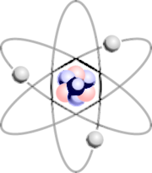
Quantum Programs
Circuits
Qubits
Superposition
Entanglement
Quantum Circuits
Classical Control
Results
Notes:
Adjunction diagram () maybe remove entanglement and superpos.

Slide 4








CIRCUITS
$$|0⟩$$
H
$$|0⟩$$
$$|0⟩|0⟩$$
$$\left|0\right\rangle |0⟩+\left|1\right\rangle |0⟩$$
$$\left|0\right\rangle |0⟩+\left|1\right\rangle |1⟩$$
$$\left|0\right\rangle |0⟩$$
$$(\left|0\right\rangle +\left|1\right\rangle )|0⟩$$
$$\left|1\right\rangle |1⟩$$
Notes:
Animate second q state

Slide 5
Sources of Bugs
Provide the wrong argument to a gate
Apply a gate to the wrong wire, or vice-versa
Forget to measure and discard certain qubits
Classically compute the wrong circuit

Slide 6
Possible Approaches
Simulation
Debugging
Unit Tests
Pencil & Paper

Slide 7
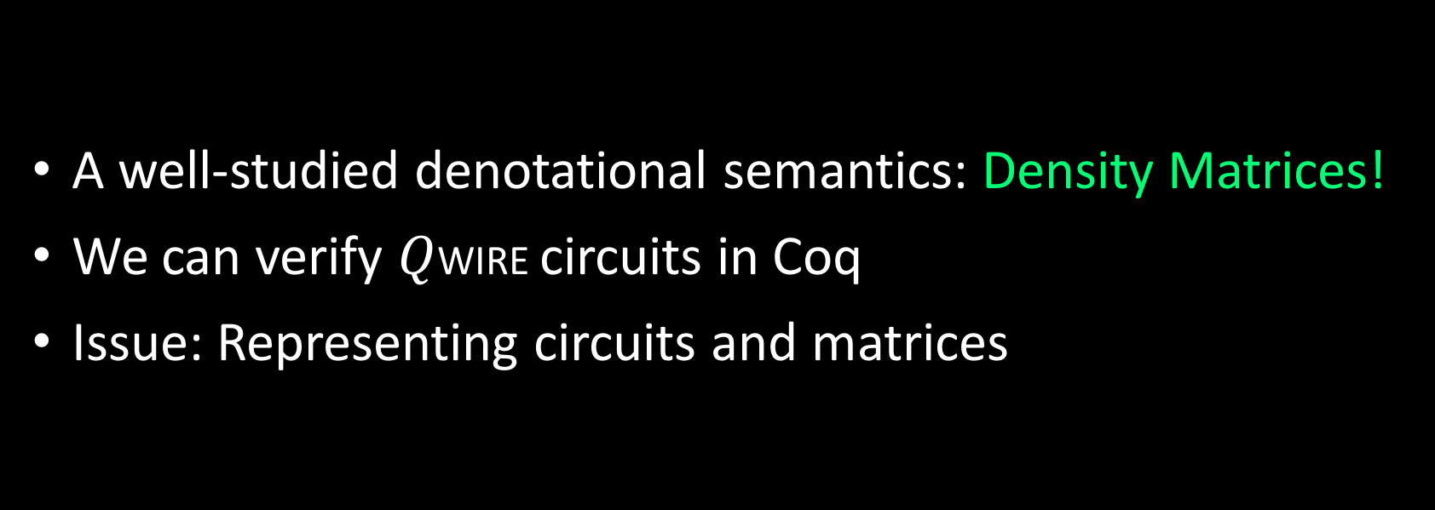
Verification
A well-studied denotational semantics: Density Matrices!
We can verify $Q$WIRE circuits in Coq
Issue: Representing circuits and matrices
Notes:
Maybe make bullet three its own slide?

Slide 8
Trade-offs
Dependent Types
Expressivity
of Types
Phantom Types
Simple types
No types
Ease of Use

Slide 9
Phantom Types
“a parametrised type whose parameters do not all appear on the right-hand side of its definition”
- Haskell Wiki

Slide 10
Phantom Matrices
'M_(m,n) [ssreflect style]
Matrix (m n : nat) := nat -> nat -> C
Expressivity
of Types
Phantom Matrix
Matrix
No type
Simplicity of Computation
Notes:
Show A : Matrix

Slide 11
Why Functions?
A † i j := (A j i)^*
(I n) i j := if (i =? j) && (i <? n) then 1
else 0

Slide 12
Why Phantom Types?
(A : Matrix m n) × (B : Matrix n o) i j :=
sum n (fun x => A i x * B x j)
(A : Matrix m n) ⊗ (B : Matrix o p) i j :=
A (i/m) (j/n) * B (i%m) (j%n)
Notes:
Maybe show a kron product?

Slide 13
Why Not Full Dependent Types?
Carrying around natural number proofs
Kronecker product multiplies dimensions
⊗ : Matrix m n -> Matrix o p -> Matrix mo np
Bounded nats are hard to compute with

Slide 14
What Can We prove?
Lemma kron_mixed_product : ∀ A B C D, (A ⊗ B) × (C ⊗ D) = (A × C) ⊗ (B × D).
Associative, commutative, distributive laws.
Most relevant theorems about matrices.
Notes:
Clarify: USING FUNCTIONAL EXTENSIONALITY

Slide 15

What Can’t We prove?
A × I = A
I × A = A
I1 $⊗$ A = A (other direction is fine)
We need a well-formedness condition

Slide 16

Well-Formedness Condition
Definition WF_Matrix {m n} (A : Matrix m n) := ∀ i j, i $≥$ m $∨$ y $≥$ j $→$ A i j = 0.
Notes:
picture?

Slide 17
Proved!
Lemma mmult_1_l: ∀ A, WF_Matrix A ->
I × A = A
Lemma mmult_1_r: ∀ A, WF_Matrix A ->
A × I = A
Lemma kron_1_l : ∀ A, WF_Matrix A ->
I1 ⊗ A = A.

Slide 18
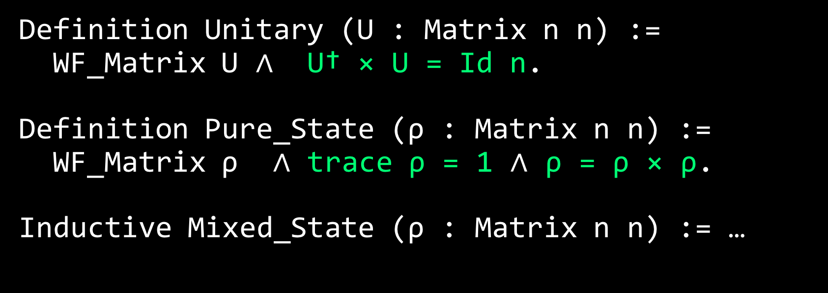
Quantum Matrices
Definition Unitary (U : Matrix n n) :=
WF_Matrix U $∧$ U† × U = Id n.
Definition Pure_State (ρ : Matrix n n) :=
WF_Matrix ρ $∧$ trace ρ = 1 $∧$ ρ = ρ × ρ.
Inductive Mixed_State (ρ : Matrix n n) := …

Slide 19





Quantum Circuits
$$C$$
$$\left(\begin{matrix}1 & ⋯ & 0 \\ ⋮ & ⋱ & ⋮ \\ 0 & ⋯ & 0\end{matrix}\right)$$
$$\left(\begin{matrix}0 & ⋯ & 0 \\ ⋮ & ⋱ & ⋮ \\ 0 & ⋯ & 1\end{matrix}\right)$$
m
n
$$2^{m}×2^{m}$$
$$2^{n}×2^{n}$$
⟦C⟧ : Matrix 2^m 2^m -> Matrix 2^n 2^n

Slide 20
Circuit Types
Specify circuit arity
Guarantee matching wire types
Enforce linearity
(NO CLONING)

Slide 21
Linear Types
Inductive Circuit : Ctx → WType → Set := | output : ∀ {Γ w}, Pat Γ w → Circuit Γ w | gate :∀{Γ Γ1 Γ1' w1 w2 w} {pf : Γ1' = Γ1 ⋓ Γ},
Gate w1 w2 →
Pat Γ1 w1 → (∀{Γ2 Γ2'} {pf2 : Γ2' = Γ2 ⋓ Γ}, Pat Γ2 w2 → Circuit Γ2' w) → Circuit Γ1' w
Notes:
Show that Gamma is a typing context

Slide 22
Linear Types
Inductive Circuit : Ctx → WType → Set := | output : ∀ {Γ w}, Pat Γ w → Circuit Γ w | gate :∀{Γ Γ1 Γ1' w1 w2 w} {pf : Γ1' = Γ1 ⋓ Γ},
Gate w1 w2 →
Pat Γ1 w1 → (∀{Γ2 Γ2'} {pf2 : Γ2' = Γ2 ⋓ Γ}, Pat Γ2 w2 → Circuit Γ2' w) → Circuit Γ1' w

Slide 23
Linear Types
Inductive Circuit : Ctx → WType → Set := | output : ∀ {Γ w}, Pat Γ w → Circuit Γ w | gate :∀{Γ Γ1 Γ1' w1 w2 w} {pf : Γ1' = Γ1 ⋓ Γ},
Gate w1 w2 →
Pat Γ1 w1 → (∀{Γ2 Γ2'} {pf2 : Γ2' = Γ2 ⋓ Γ}, Pat Γ2 w2 → Circuit Γ2' w) → Circuit Γ1' w

Slide 24
Constructing Circuits
Definition bell00 : Box One (Qubit ⊗ Qubit). refine( box_ () ⇒ gate_ a ← init0 @();
gate_ b ← init0 @();
gate_ a ← H @a;
gate_ z ← CNOT @(a,b);
output z); type_check.
Defined.

Slide 25
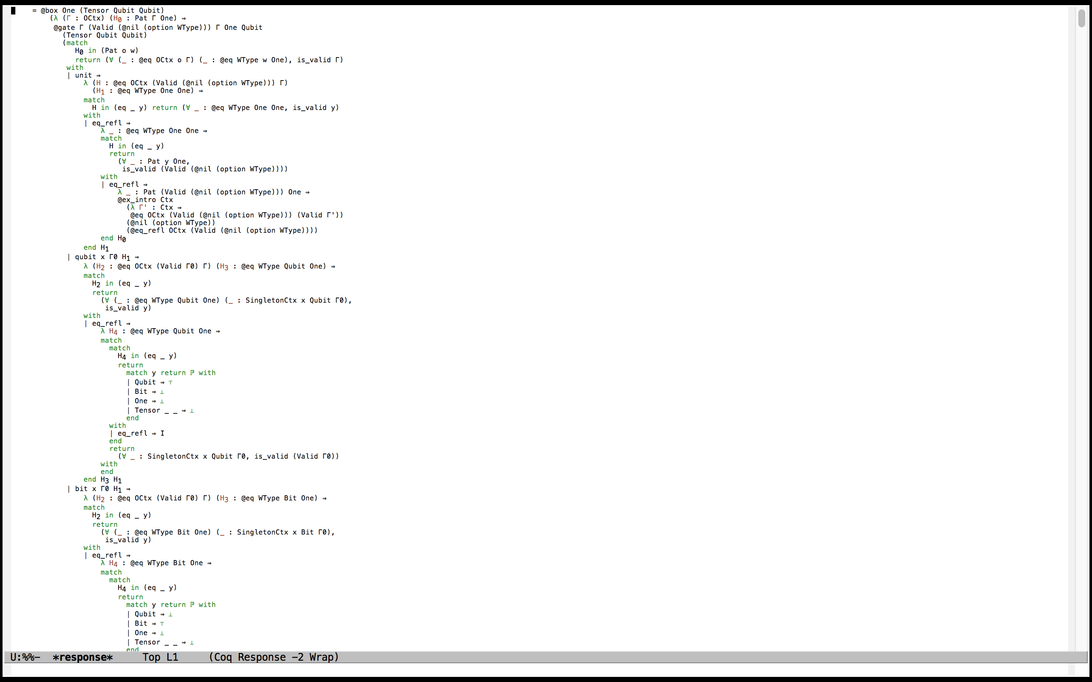

Slide 26
Phantom Circuits
Inductive Circuit (w : WType) : Set :=
| output : Pat w → Circuit w
| gate : ∀ {w1 w2},
Gate w1 w2 → Pat w1 → (Pat w2 → Circuit w) → Circuit w

Slide 27
PHANTOMISH Circuits
Definition wproj {W1 W2} (p : Pat (W1 ⊗ W2)):= match p with
| pair p1 p2 => (p1, p2)
end.

Slide 28
PHANTOMISH Circuits
Definition teleport :=
box_ q ⇒
let_ (a,b) ← bell00 () ;
let_ (x,y) ← alice (q,a) ;
bob (x,y,b).

Slide 29
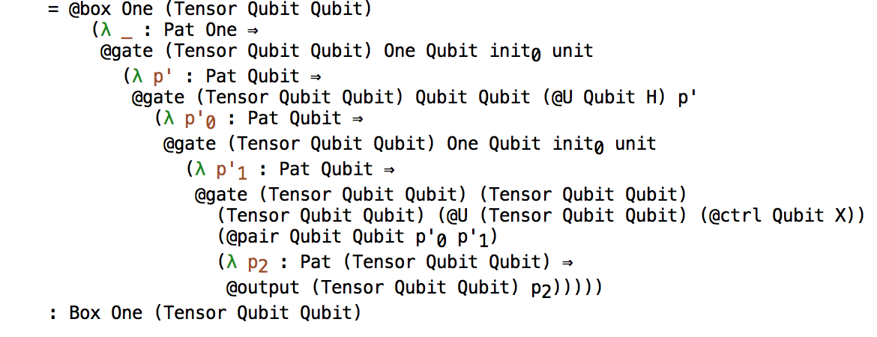
Bell₀₀ (new)

Slide 30
Well-Typed
Inductive Types_Circuit {w} : Ctx → Circuit w → Prop := | types_output : ∀ {Γ w} {p : Pat w},
Γ ⊢ p :Pat → Types_Circuit Γ (output p) | types_gate : ∀ {Γ Γ1 Γ1' w1 w2 w}
{f : Pat w2 → Circuit w} {p1 : Pat w1}
{g : Gate w1 w2}, Γ1 ⊢ p1 :Pat →
(∀ Γ2 Γ2' (p2 : Pat w2) {pf2 : Γ2' = Γ2 ⋓ Γ}, Γ2 ⊢ p2 :Pat -> Types_Circuit Γ2' (f p2)) → ∀ {pf1 : Γ1' = Γ1 ⋓ Γ},
Types_Circuit Γ1' (gate g p1 f)

Slide 31
Further Challenges
Computational complex numbers
Efficient matrix representations
Arrays?
Tree based?
Graphical?
Fast matrix multiplication

Slide 32
Other CHallenges
Scaling issues (evars)
Proof erasure
Circuit / Variable representation

Slide 33
Available online
https://github.com/jpaykin/QWIRE

Slide 34
Why Not SSReflect Matrices?
Missing core operations – Kronecker product and adjoint
Strong dependent types – have to include proof terms of matching sizes.
Less lightweight - finite functions backed by lists.
Hard to compute with.

Slide 35
Why Not Coquelicot Matrices?
List based matrices
Slower for computing transpose, kronecker product.
Limited operations

Slide 36
Complex Numbers
Coquelicot’s conservative extension of the Coq reals.
Good: Can use ring / field / lra!
Bad: Not computational.

